Slide 1
Basic C# & UI

Slide 2
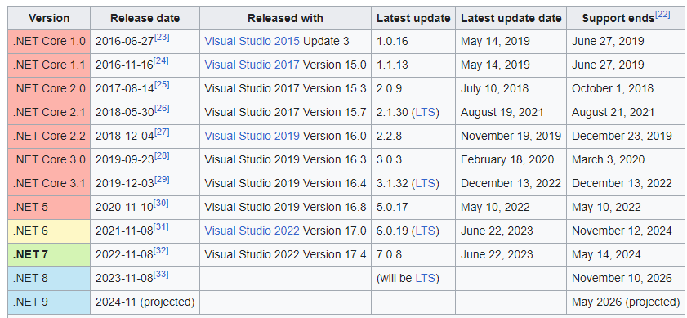
.Net
Software framework by Microsoft
From Wikipedia, last update: July 2023

Slide 3
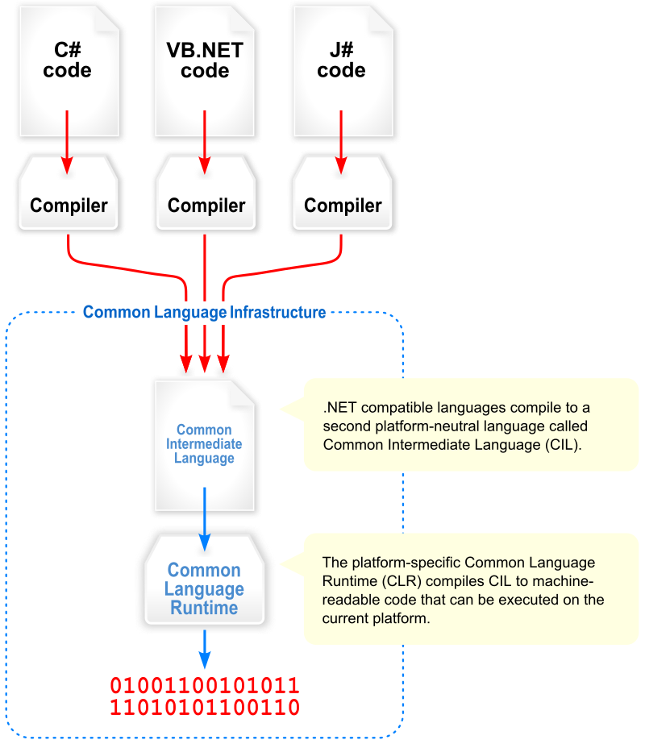
Mechanism

Slide 4
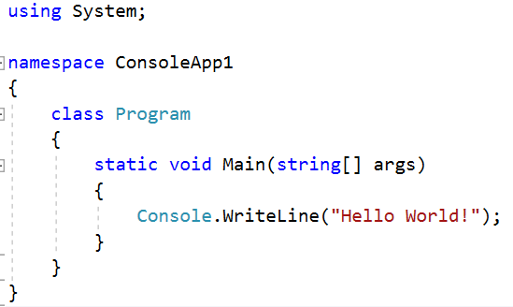

Hello world & artifacts
Create a new console app

Slide 5
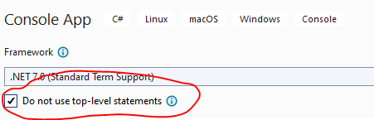
Top level statements

Slide 6
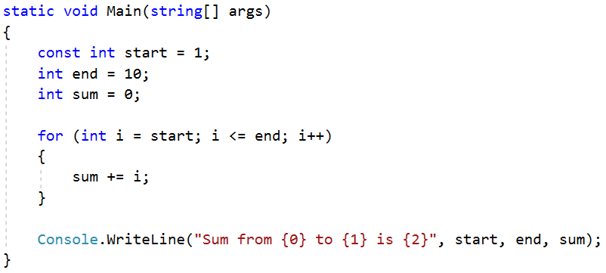

Constants & Variables
Write a program that calculate sum from 1 to 10

Slide 7
Messing around
Position of parameter for string format
String interpolation
Function examples
ref / out

Slide 8
Artifact
Build => Error
Run vs Run without debugging
Release
Debug
Breakpoint & watch
Step in & Step over & step out
Set as startup project
Open project location

Slide 9
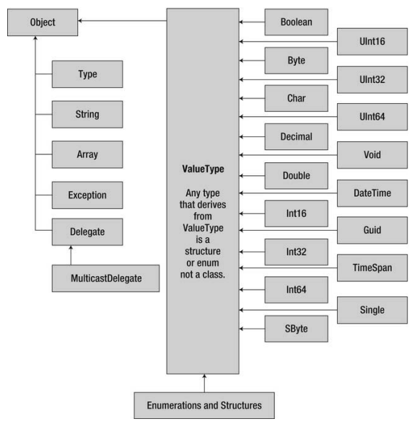
Types

Slide 10
Exercise
Write a function to check if
An integer is a prime number
An integer has all odd digits

Slide 11
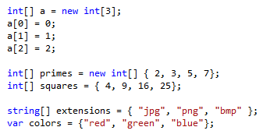
Array

Slide 12
Exercises
Given a date stored in 3 variables: day, month, year
Write a function to check if these variables create a valid date
Write a helper function to check for leap year
Write a function that prints out the previous day
Write a function that prints out the next day
Advanced: make all these above functions part of class DateTime

Slide 13
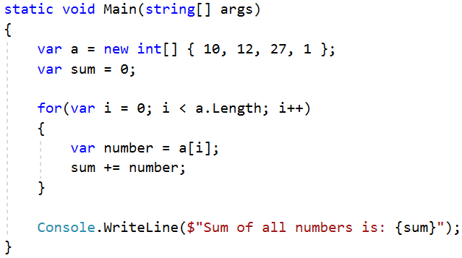


Loop through an array

Slide 14
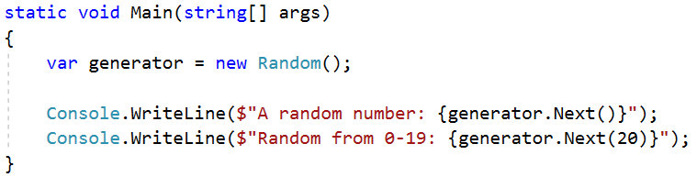
Random generator

Slide 15
Exercise
Generate 10 integers into an int array
Check if all integers are even numbers
Count the number of prime numbers
Create a sub array that contains all odd numbers

Slide 16
Number casting
// Smalle to big -> OK
byte b = 5; // implicit int to byte
int i = b; // i = 5
// Big to small -> NOT OK
int i = 500;
byte j = i; // compile error
byte j = (byte)i; // i = 244

Slide 17
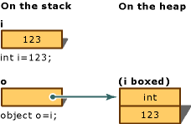
Boxing / Unboxing
Boxing: convert value type to object
Unboxing: extract value type from object

Slide 18
Exercise
Understanding the boxing/unboxing mechanism
int i = 7;
string name = i.ToString() + “ $”;
int result = i.CompareTo(100);

Slide 19
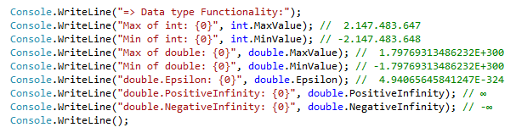
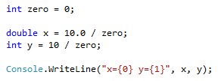
Minimum & maximum value
Result?
Notes:
Số nguyên chia cho 0 thì văng exception
Số thực chia cho 0 thì ra infinity :v

Slide 20
Operation 1/2
References: . () [] new ->
Arithmetic: + ++ - -- * / % sizeof
Logical: & | ^ !
Conditional: && (&) || ! == != > >= < <=
Type verification: is as typeof
Bitwise: ~ >> <<
Assignment: = += -= *= /= %= &= |= ^= >>= <<=
Selection: ?: ?? (not null)
Lambda expression definition: =>

Slide 21
Operation 2/2
int i = 5;
// Selection ?:
string x = i == 5 ? "Yes": "No";
int? x = 5; // nullable type
int y = x ?? 0; // Selection ?? operator
int z = x; // Error: nullable type
// cannot assign to non-nullable type
// Lambda expression – anonymous method
(int x) => x * 2; <=>
public int Double(int x){return x * 2;}

Slide 22

Use String format for concatenation
Positive: right align, negative: left align

Slide 23


String concatenation
Use “+” character
Use StringBuilder
Question: what should we use, + or StringBuilder?

Slide 24
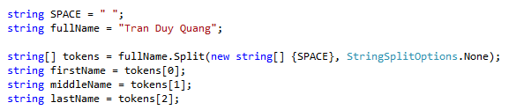
String Split
Exercise
Calculate sum of string numbers = “5, 3, 8, 11, -12, 3”
Split String fraction = “3/4” into int numerator and denominator
What if we meet 3//4?

Slide 25
Format string in VND
CultureInfo cul = CultureInfo.GetCultureInfo("vi-VN"); // en-US en-UK
int money = 1250000;
string message = money.ToString("#,### đ", cul.NumberFormat);
string message = string.Format(info, "{0:c}", money);
$n, n$, $ n, n $
1.000.000,29 đ 10/07/2023
$ 1,000,000.29 07/10/2023
Cùng 1 dữ liệu => nhiều cách hiển thị khác nhau

Slide 26
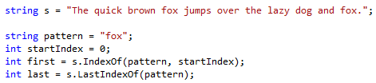
String search
Exercise
Given string s = “She sells seashells by the seashore. The shells she sells are seashells”
Calculate the number of occurrence of the word “sells” and “she”
Further reading: replace and regular expression

Slide 27
String Exercises
1. Read a string and give statistics about the number of occurrence for each of the word in the string.
2. Normalize a string of full name and print out on the screen: no more than one spaces between words, the first letter is capitalized meanwhile the rest are in lower case, no space in the beginning and the end of the string.
3. Split String fullpath = “C:\Documents\Photos\Test.jpg” into a) Containing directory b) File name c) Extension

Slide 28
DateTime
using System;
DateTime a = new DateTime();
// Full construction
DateTime b = new DateTime(2013, 06, 15, 15, 28, 31, 927);
// Current time
DateTime c = DateTime.Now;

Slide 29
Datetime string display
var cul = CultureInfo.GetCultureInfo("vi-VN");
var now = DateTime.Now;
now.ToString(cul); // 10/07/2023 18:34:25
now.ToLongDateString(); // Monday, July 10, 2023
now.ToShortDateString(); // Mon 10 07 2023
How about 10-07-2023?
now.ToString("dd-MM-yyyy", CultureInfo.InvariantCulture)

Slide 30
Flow control
Branching
Selection: ?: ??
if… else if … else
switch … case … default
Iteration
for
foreach
do while
while
Ignore & breaking
continue
break

Slide 31
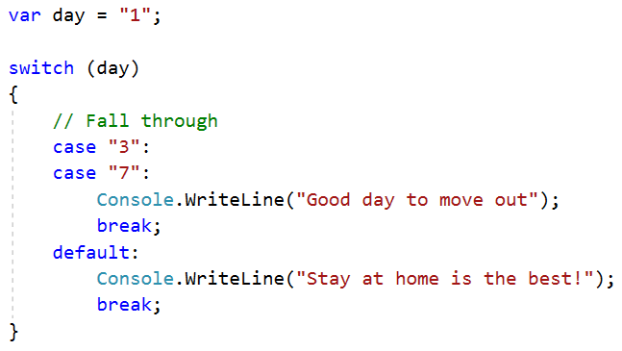
switch case example

Slide 32
Tuple
Creating a tuple
Accessing elements in a tuple
Destructuring a tuple into multiple elements

Slide 33
Basic coding convention

Slide 34
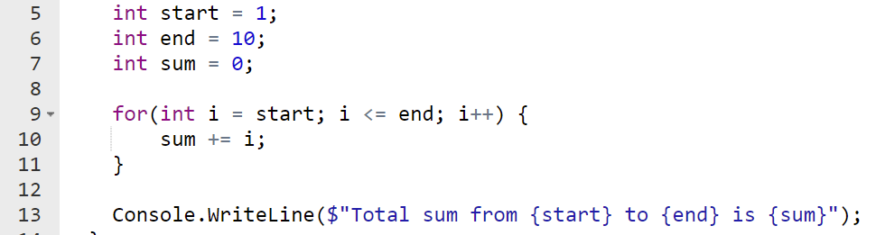
if for do while
Add an empty line before and after
Always use brackets even if there is one line of code

Slide 35
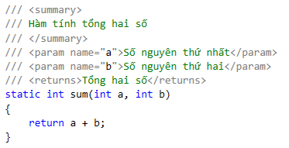
Comment
Should provide purpose of a block of function
XML comment for document generation (doxygen)

Slide 36
Function name
Start with a verb
Private: _camelCase
Public: PascalCase
Good: isPrime, checkExists, called, calling
didCall, willChange
Avoid: doCalculate => calculate
Quiz: Check if a element exists in an array

Slide 37
Constants
PascalCase

Slide 38
Exercises
Check if a number is a prime number
bool IsPrime(int number) / LaSoNguyenTo()
Check if a number is a square number
bool isSquare(int number) / LaSoChinhPhuong()
Calculate x^{n}
double Pow(double x, int n) / LuyThua

Slide 39
Basic UI with WPF

Slide 40
WPF
Create WPF app
UI is written in xaml language
Code behind is C#

Slide 41
4 basic controls
Canvas: Left, Top
Label: Content
TextBox: Text, Margin
Button: Content
Image: Content type = Resource
Uri: Relative
BitmapImage
MessageBox.Show

Slide 42
HomeworkWeek01
1. InspiringQuotes
Display a random inspiring quote and an illustration image.
Source: https://motivationping.com/quotes
(15 quotes required)
2. EnglishVocabulary
Display a random word with image
(15 words required)

